Slide 1
Power BI Embedded
FSI CSU SWARM

Slide 2
Ways to Embed Power BI

Slide 3
Abstract and learning objectives
Learn the ways to Embed Power BI objects

Slide 4
Ways to Embed Power BI
Embedded | With Power BI Embedded in Azure, you can embed reports, dashboards, or tiles into an application using app owns data. App owns data is about having an application that uses Power BI as its embedded analytics platform. As an ISV developer, you can create Power BI content that displays reports, dashboards, or tiles in an application that is fully integrated and interactive, without requiring users to have Power BI license.

Slide 5
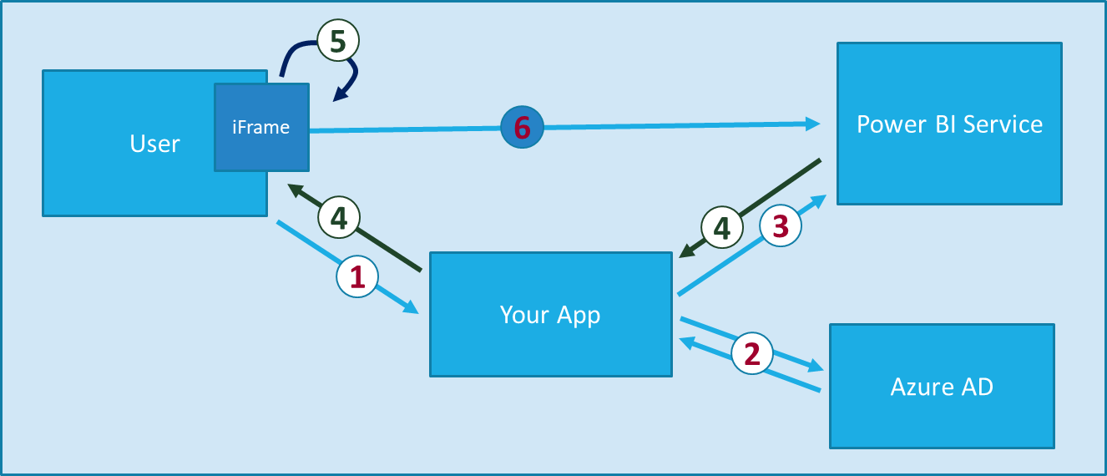
Power BI Embedding The Big Picture
User launches your app using a browser
App authenticates with azure active directory and obtains access token
App uses access token to call to power BI service API
App retrieves data for embedded resource and passes it to browser.
Client-side code uses Power BI JavaScript API to create embedded resource
Embedded resource session created between browser and power BI service
Notes:
https://docs.microsoft.com/en-us/power-bi/developer/embedding

Slide 6
Embedding for your Organization
Allows you to extend the Power BI service.
Embedding for your organization requires that users of your application sign into the Power BI service when they want to view the content. Once someone in your organization signs in, they only have access to dashboards and reports that they own or that someone shared with them in the Power BI service.
Examples of embedding for your organization include internal applications, such as SharePoint Online, Microsoft Teams integration (you must have Admin rights), and Microsoft Dynamics.

Slide 7
Embedding for your Organization
For embedding for your organization, see below:
Integrate a report into an app
Self-service capabilities, such as edit, save, and more, are available through the JavaScript API when embedding for Power BI users.
ISVs can achieve faster time to market by minimizing visual analytic development efforts and stand out among the competition with differentiated data experiences.

Slide 8
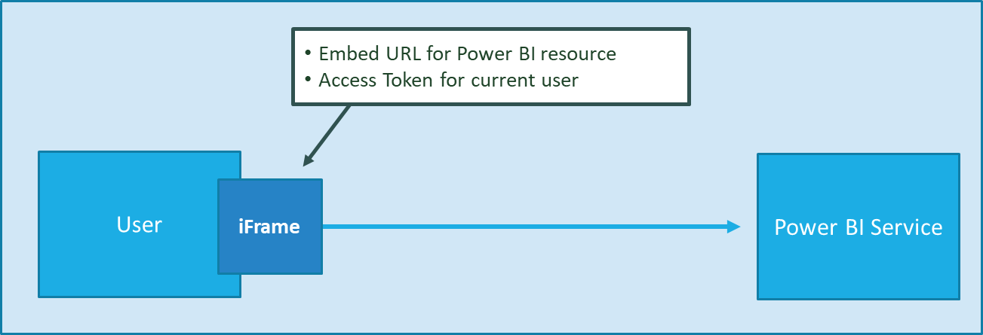
Embedding for your Organization
App authenticates current user with Azure AD
Your code accesses Power BI Service as current user
Embedding requires Azure AD access token for user
User requires Azure AD account and Power BI license
Your code has access to whatever user has access to

Slide 9
Embedding for your Customers
Lets you embed dashboards and reports for users who don't have an account for Power BI. Embedding for your customers is known as Power BI Embedded.
Microsoft Azure service that lets independent software vendors (ISVs) and developers quickly embed visuals, reports, and dashboards into an application through a capacity-based, hourly metered model.

Slide 10
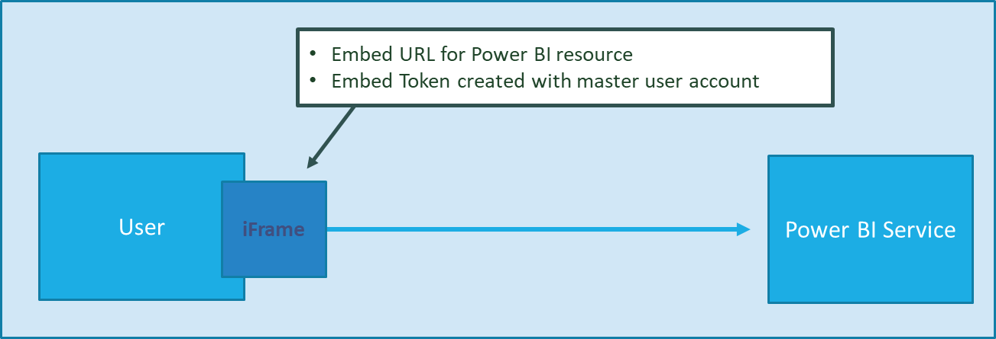
Embedding for your Customers
App authenticates using Master User Account
Your code accesses Power BI Service as master user
Embedding uses embed token instead of access token
Users don’t need AAD accounts and Power BI licenses
Your code has access to whatever master has access to

Slide 11
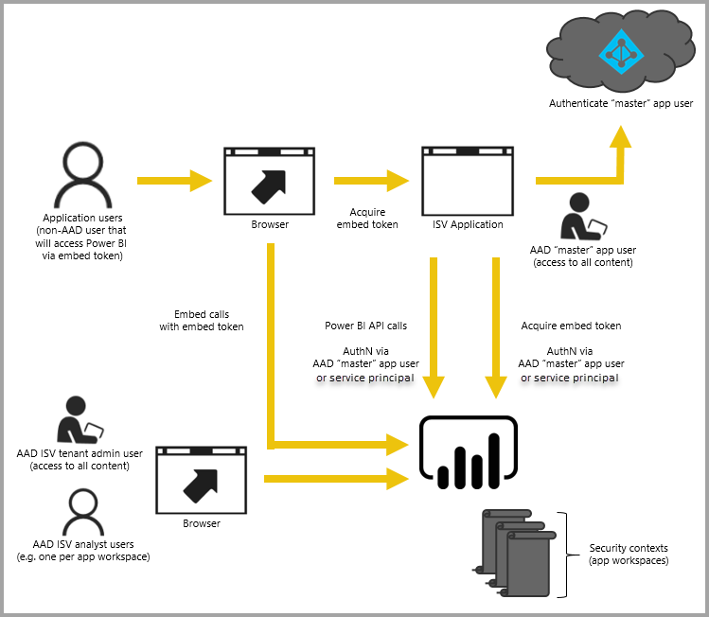
Embedding for your Customers
You can use two different methods to create an embedded application. One option is to use a Power BI Pro account. Another option is to use service principal.
The Power BI Pro account acts as a master account for your application (think of this master account as a proxy account). The Power BI Pro account allows you to generate embed tokens that provide access to dashboards and reports within the Power BI service that are owned and managed by your application.
Service principal can embed Power BI content into an application using an app-only token. Service principal allows you to generate embed tokens that provide access to dashboards and reports within the Power BI service that are owned and managed by your application.

Slide 12
Your Organization vs Your Customer Embedding
Organization
Customer
Organizations where users have Power BI licenses
Embedding Power BI reports in SharePoint and Teams
Development should go beyond out-of-box experience
Scenarios where users don’t have Power BI licenses
Applications which have custom identity providers
Applications which use identity provider other than AAD

Slide 13
Your Organization vs Your Customer Embedding
 | Organization | Customer
Authentication flow | Authentication Code Grant Flow or Implicit Flow | Direct User Credentials
Identity used to call Power BI | Current User | Master User Account
Access to personal workspace | Yes | No
Access to app workspaces | Yes | Yes
Ability to reach non-licensed users | No | Yes
Supported Power BI Capacity SKUs | P* and EM* SKUs | P*, EM* and A* SKUs

Slide 14
Embed for Sovereign Clouds
Power BI supports sovereign (private) clouds, such as:
The different sovereign clouds are:
U.S. Government Community Cloud (GCC)
U. S. Military Contractors (DoDCON)
U. S. Military (DoD)
Power BI for Germany cloud
Power BI for China cloud

Slide 15
Advanced Topics

Slide 16
Embed for Organization
Notes:
https://docs.microsoft.com/en-us/power-bi/developer/embed-sample-for-your-organization

Slide 17
Embed for Organization
Embedding for your customers within your application requires you to get an access token for your master account or service principal from Azure AD. You're required to get an Azure AD access token for your Power BI application before you make calls to the Power BI REST APIs.

Slide 18
Create Token
To create the Power BI Client with your access token, you want to create your Power BI client object, which allows you to interact with the Power BI REST APIs. You create the Power BI client object by wrapping the AccessToken with a Microsoft.Rest.TokenCredentials object.
Code Snippet
using Microsoft.IdentityModel.Clients.ActiveDirectory; using Microsoft.Rest; using Microsoft.PowerBI.Api.V2; var tokenCredentials = new TokenCredentials(authenticationResult.AccessToken, "Bearer"); // Create a Power BI Client object. it's used to call Power BI APIs. using (var client = new PowerBIClient(new Uri(ApiUrl), tokenCredentials)) { // Your code to embed items. }

Slide 19
Get the content item you want to embed
You can use the Power BI client object to retrieve a reference to the item you want to embed. Here is a code sample of how to retrieve the first report from a given workspace.
A sample of getting a content item whether it's a report, dashboard, or tile that you want to embed is available within the Services\EmbedService.cs file in the sample application
Code Snippet
using Microsoft.PowerBI.Api.V2; using Microsoft.PowerBI.Api.V2.Models; // You need to provide the workspaceId where the dashboard resides. ODataResponseListReport reports = await client.Reports.GetReportsInGroupAsync(workspaceId); // Get the first report in the group. Report report = reports.Value.FirstOrDefault();

Slide 20
Create the embed token
Generated an embed token, which can be used from the JavaScript API. The embed token is specific to the item you’re embedding. So at any time you embed a piece of Power BI content, you need to create a new embed token for it. For more information, including which accessLevel to use, see GenerateToken API.
A sample of creating an embed token for a report, dashboard, or tile want to embed is available within the Services\EmbedService.cs file in the sample application.
Code Snippet
using Microsoft.PowerBI.Api.V2; using Microsoft.PowerBI.Api.V2.Models; // Generate Embed Token. var generateTokenRequestParameters = new GenerateTokenRequest(accessLevel: "view"); EmbedToken tokenResponse = client.Reports.GenerateTokenInGroup(workspaceId, report.Id, generateTokenRequestParameters); // Generate Embed Configuration. var embedConfig = new EmbedConfig() { EmbedToken = tokenResponse, EmbedUrl = report.EmbedUrl, Id = report.Id };

Slide 21
Embed for Customers
Notes:
https://docs.microsoft.com/en-us/power-bi/developer/embed-sample-for-customers

Slide 22
Client Object
To create the Power BI Client with your access token, you want to create your Power BI client object, which allows you to interact with the Power BI REST APIs. You create the Power BI client object by wrapping the AccessToken with a Microsoft.Rest.TokenCredentials object.
Code Snippet
using Microsoft.IdentityModel.Clients.ActiveDirectory; using Microsoft.Rest; using Microsoft.PowerBI.Api.V2; var tokenCredentials = new TokenCredentials(authenticationResult.AccessToken, "Bearer"); // Create a Power BI Client object. it's used to call Power BI APIs. using (var client = new PowerBIClient(new Uri(ApiUrl), tokenCredentials)) { // Your code to embed items. }

Slide 23
Get the content item you want to embed
You can use the Power BI client object to retrieve a reference to the item you want to embed. Here is a code sample of how to retrieve the first report from a given workspace.
A sample of getting a content item whether it's a report, dashboard, or tile that you want to embed is available within the Services\EmbedService.cs file in the sample application
Code Snippet
using Microsoft.PowerBI.Api.V2; using Microsoft.PowerBI.Api.V2.Models; // You need to provide the workspaceId where the dashboard resides. ODataResponseListReport reports = await client.Reports.GetReportsInGroupAsync(workspaceId); // Get the first report in the group. Report report = reports.Value.FirstOrDefault();

Slide 24
Create the embed token
Generated an embed token, which can be used from the JavaScript API. The embed token is specific to the item you’re embedding. So at any time you embed a piece of Power BI content, you need to create a new embed token for it. For more information, including which accessLevel to use, see GenerateToken API.
A sample of creating an embed token for a report, dashboard, or tile want to embed is available within the Services\EmbedService.cs file in the sample application.
Code Snippet
using Microsoft.PowerBI.Api.V2; using Microsoft.PowerBI.Api.V2.Models; // Generate Embed Token. var generateTokenRequestParameters = new GenerateTokenRequest(accessLevel: "view"); EmbedToken tokenResponse = client.Reports.GenerateTokenInGroup(workspaceId, report.Id, generateTokenRequestParameters); // Generate Embed Configuration. var embedConfig = new EmbedConfig() { EmbedToken = tokenResponse, EmbedUrl = report.EmbedUrl, Id = report.Id };

Slide 25
Wrap Up

